Slide 1
Movie Reviews Sentimental Analysis
Team Members:
Abdulrahman Khalid
Qossai Broo

Slide 2
Contents
Data Exploration.
Text Cleaning.
Text Preprocessing.
Machine Learning Models.
Deep Learning Models.
FastAPI Deployment.

Slide 3
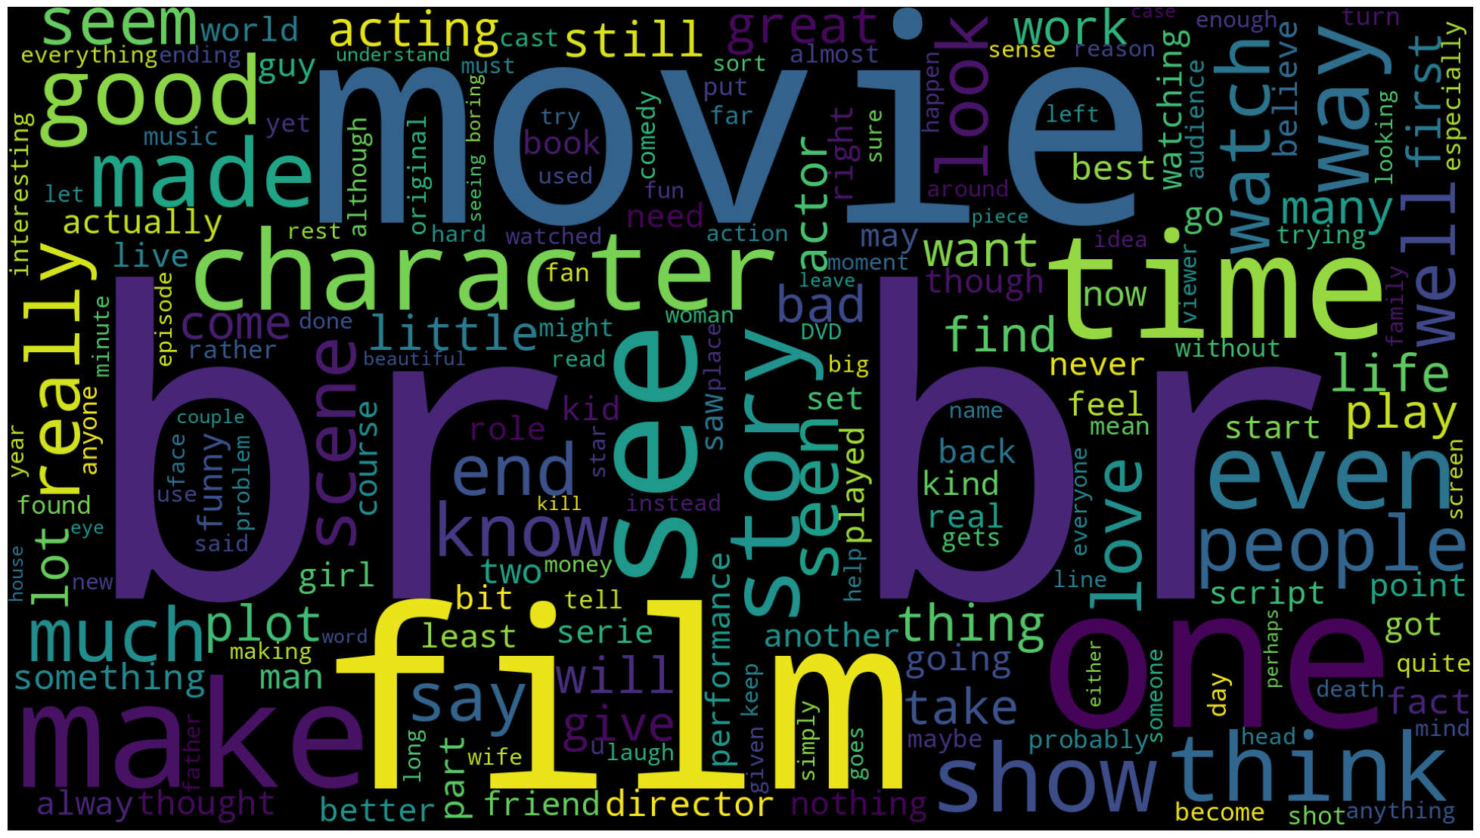
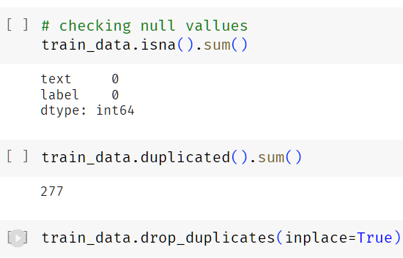
Data Exploration
Most Common Words
We have almost 40,000 Reviews for training.
We have two classes negative and positive reviews.
We can notice html tags in our data.

Slide 4
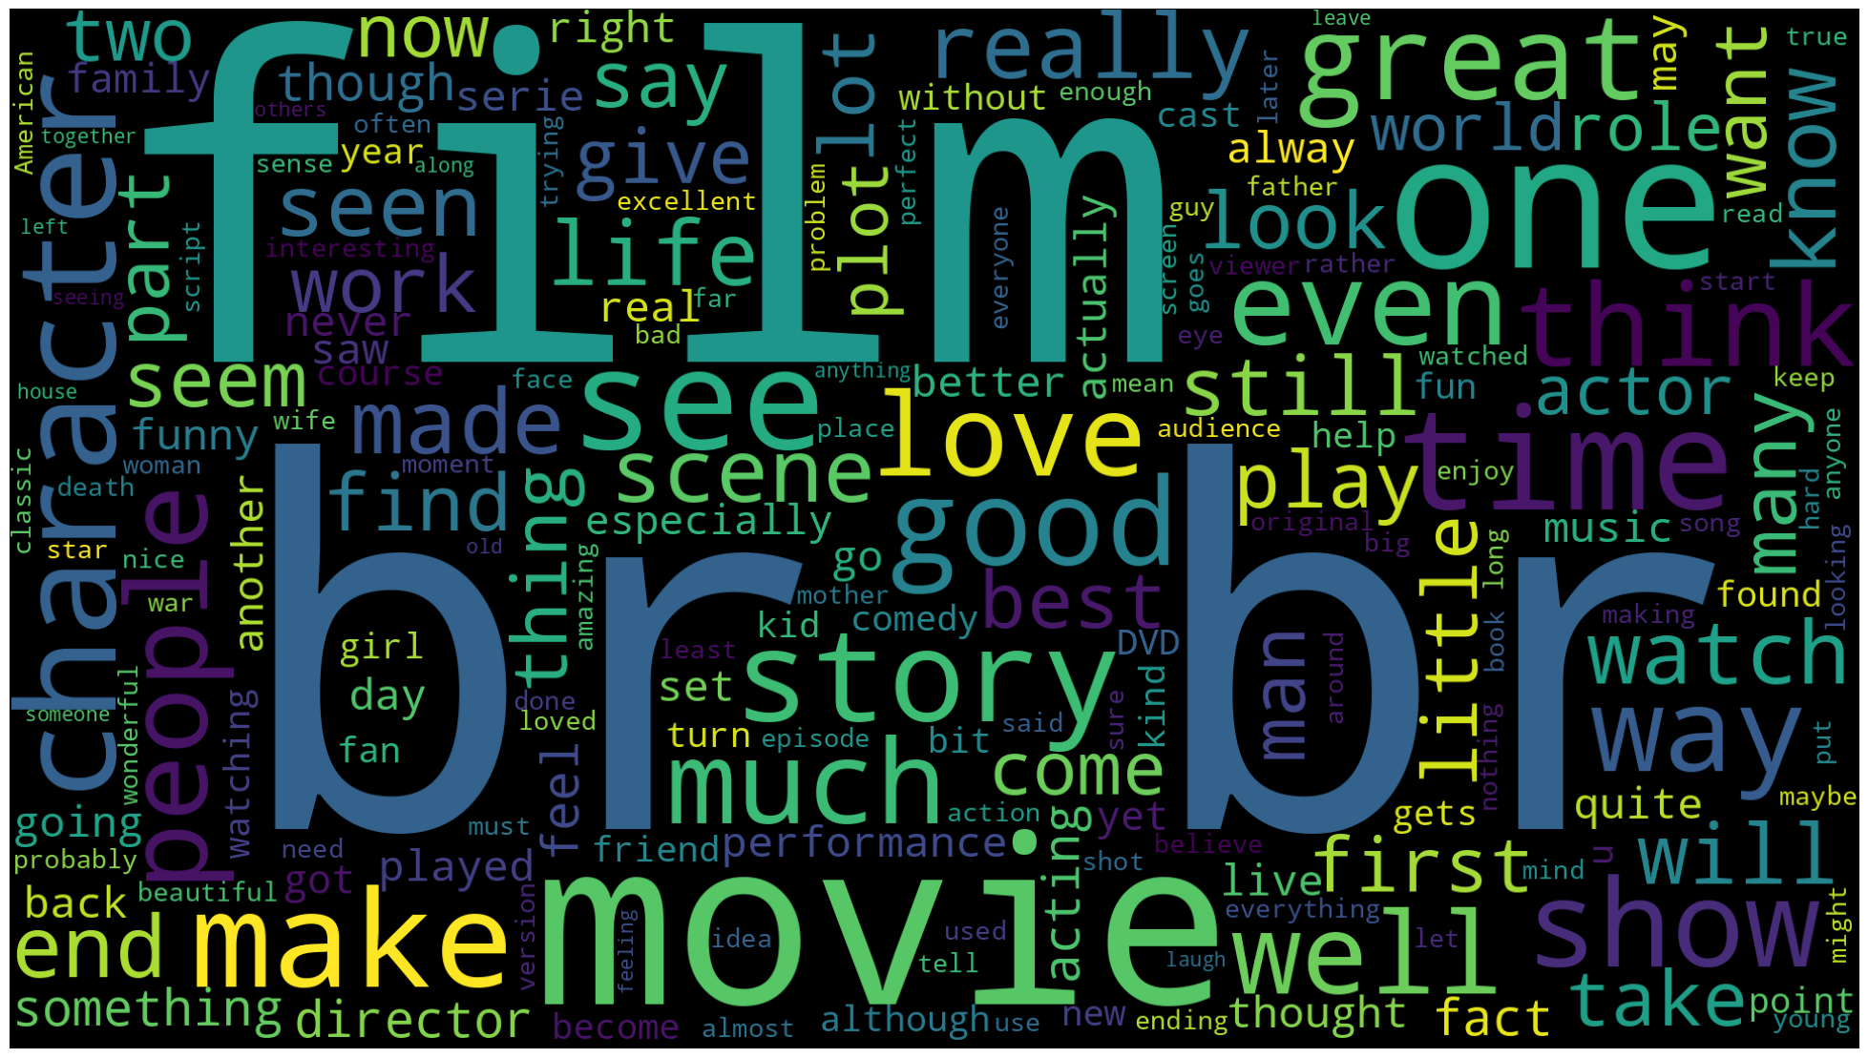
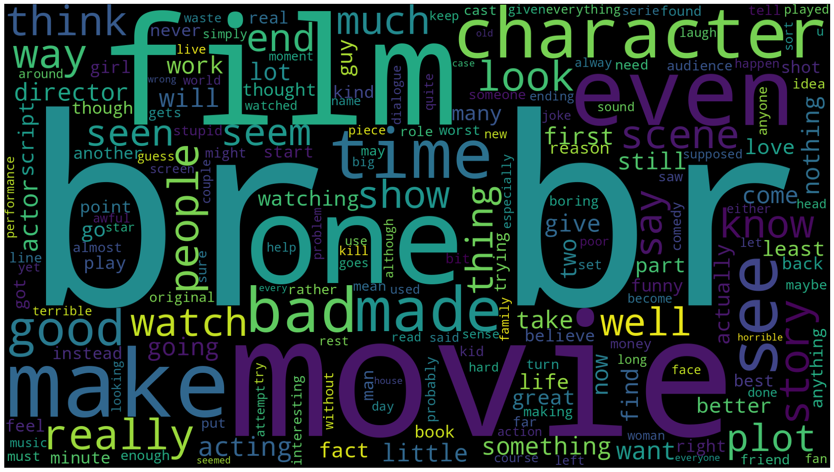
Data Exploration
Most Common Positive Words
Most Common Negative Words

Slide 5
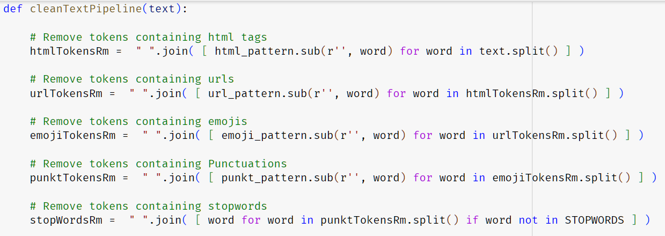
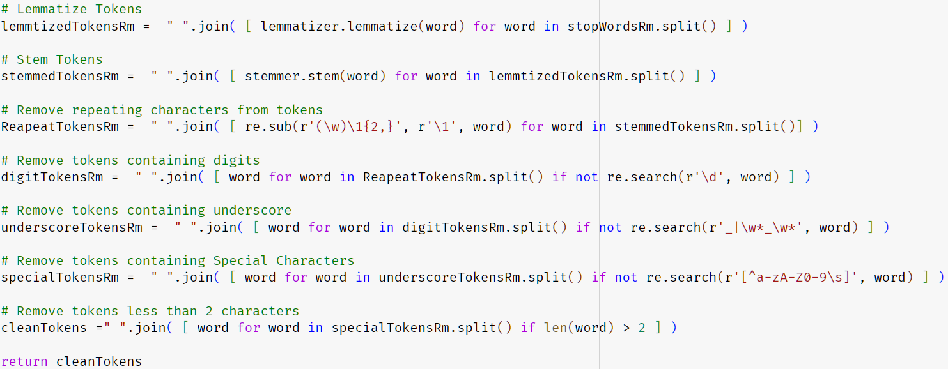
Text Cleaning
Removing HTML Tags.
Removing URLs.
Removing Emojis.
Removing Punctuation
Removing Stopwords.
Lemmatization
Stemming
Tokens Cleaning

Slide 6
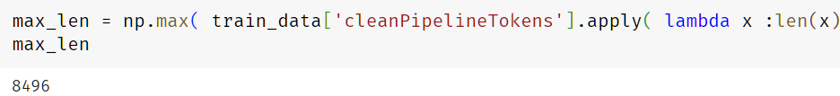
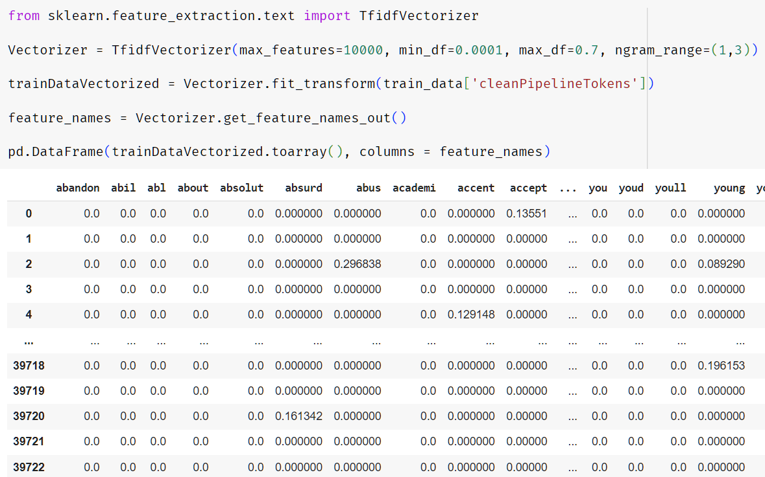
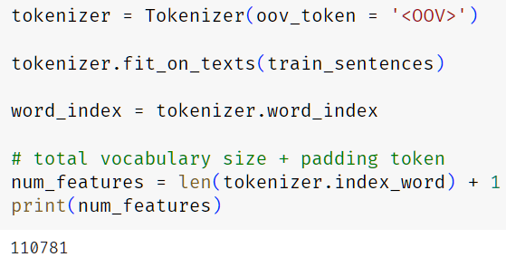
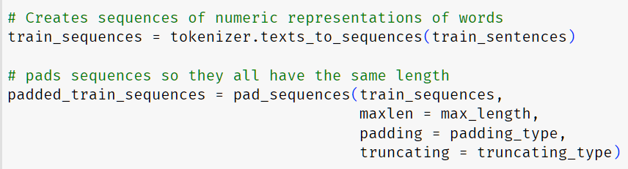
Text Preprocessing
DL Models Preprocessing
ML Models Preprocessing

Slide 7
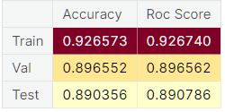
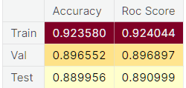
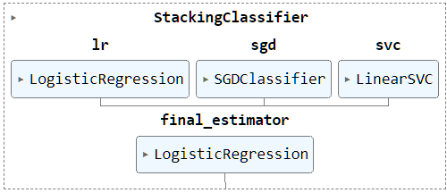
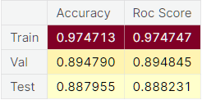
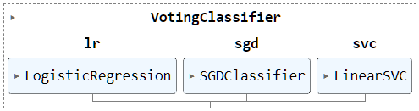
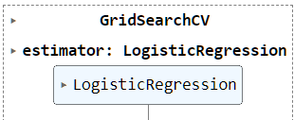
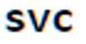

Machine Learning Models
Boosting Linear Models
Linear Models
StackingClassifier
VotingClassifier
Logistic Regressions
SGD Classifier
LinearSVC
Fine-Tuning Best Models

Slide 8
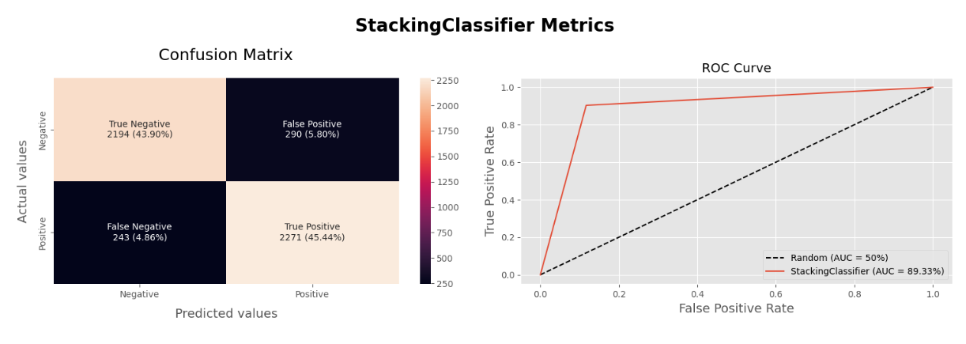
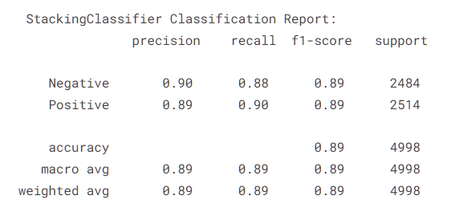
Machine Learning Models Evaluation

Slide 9
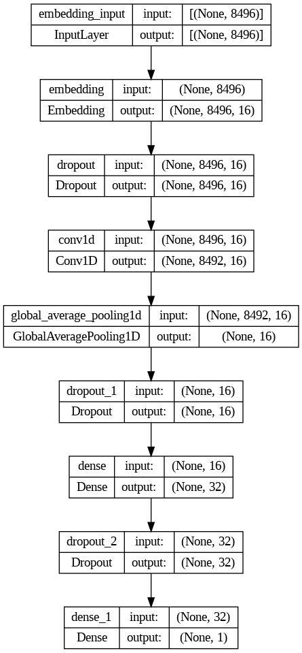
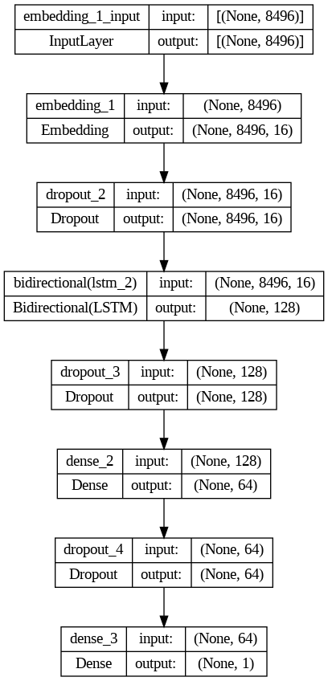
Deep Learning Models
LSTM Model
CNN Model

Slide 10
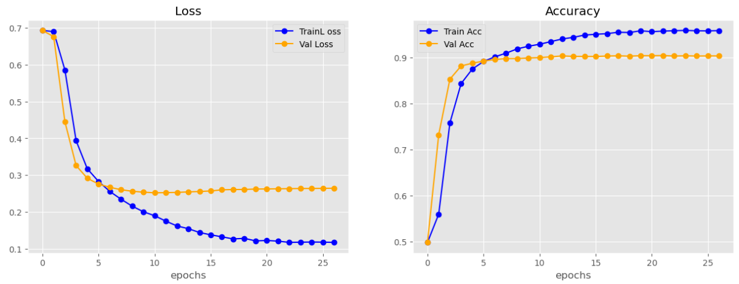
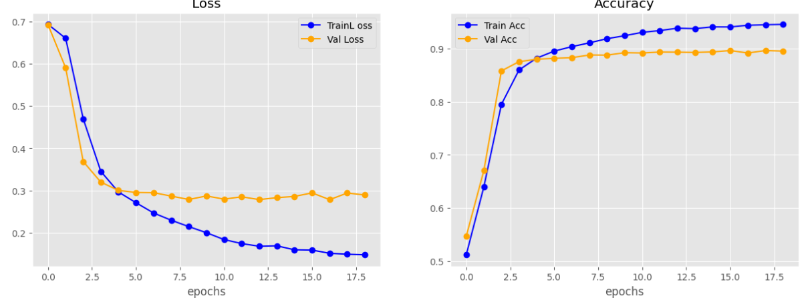
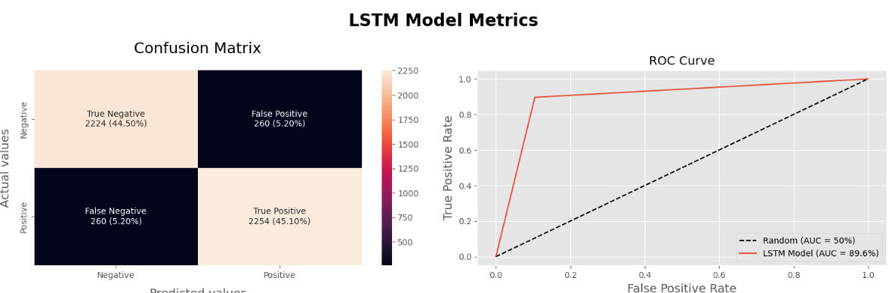
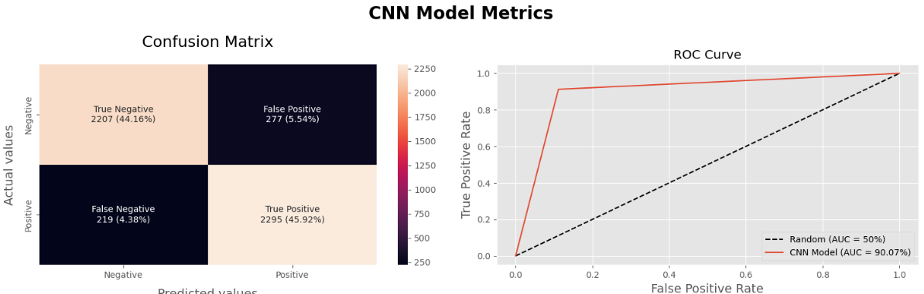
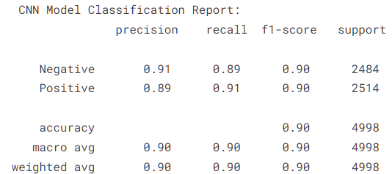
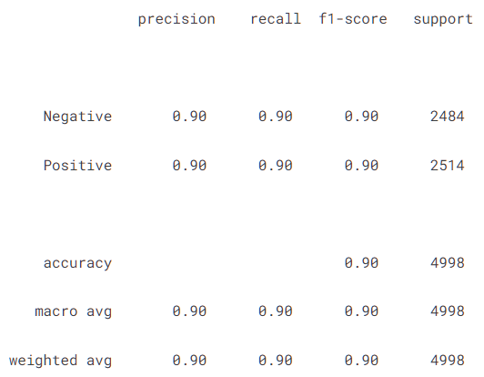
CNN Model
LSTM Model

Slide 11
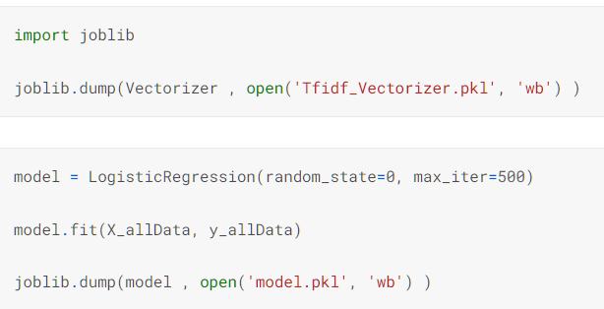
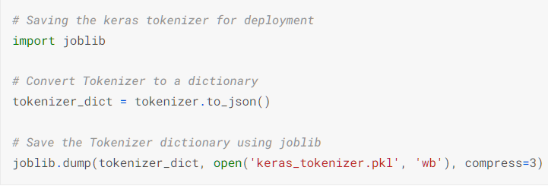
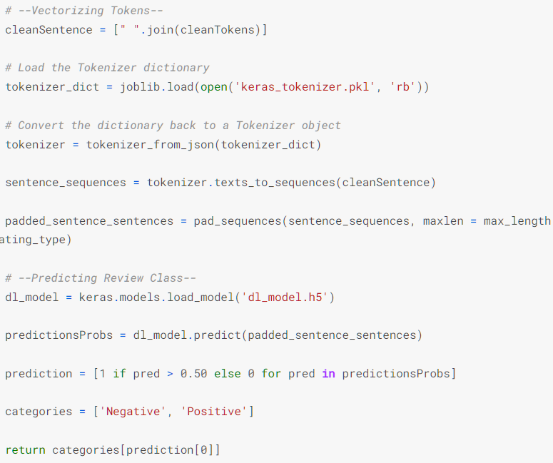
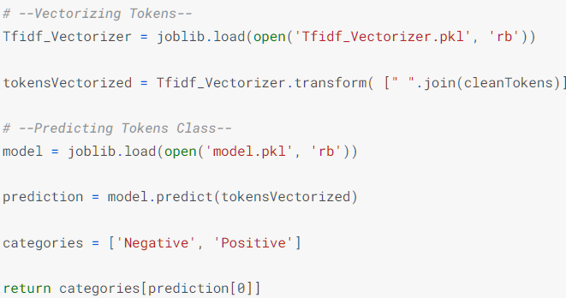
ML Deployment Pipeline
DL Deployment Pipeline

Slide 12
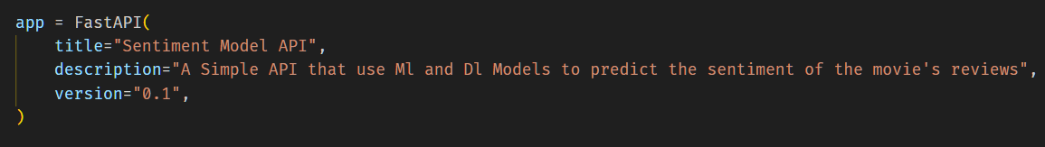
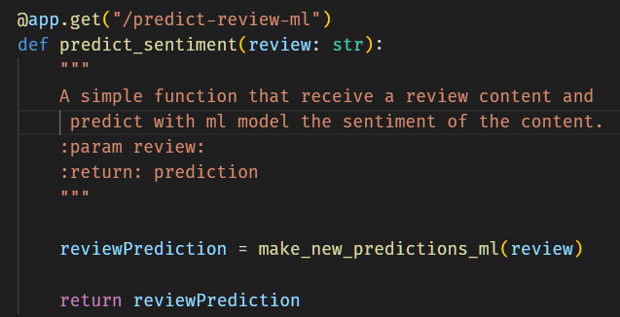
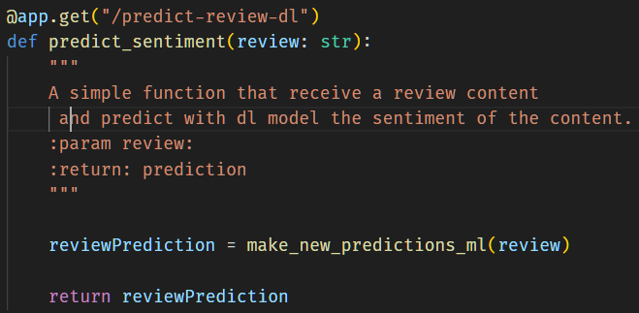
FastAPI Deployment
ML Prediction API
DL Prediction API

Slide 13
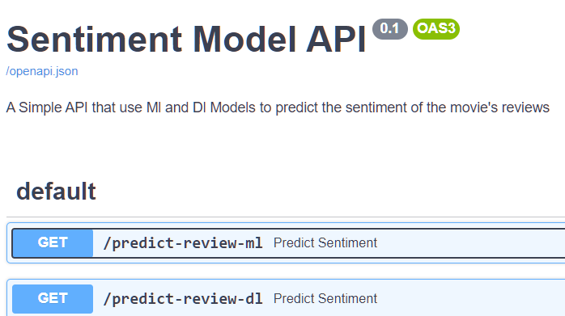
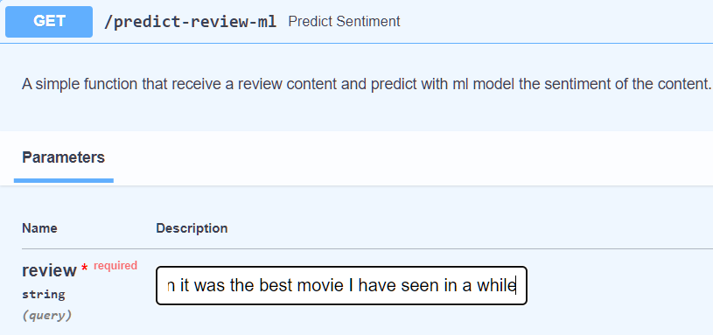
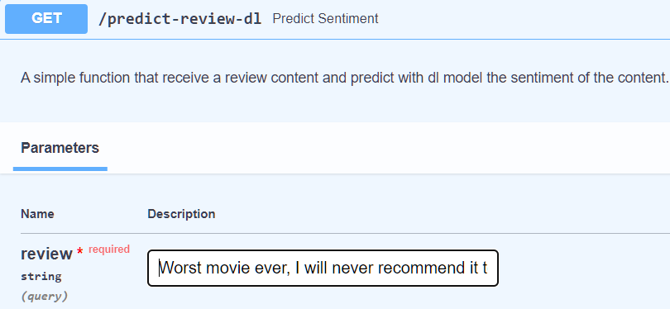
FastAPI Interface
ML Prediction API
DL Prediction API

Slide 14
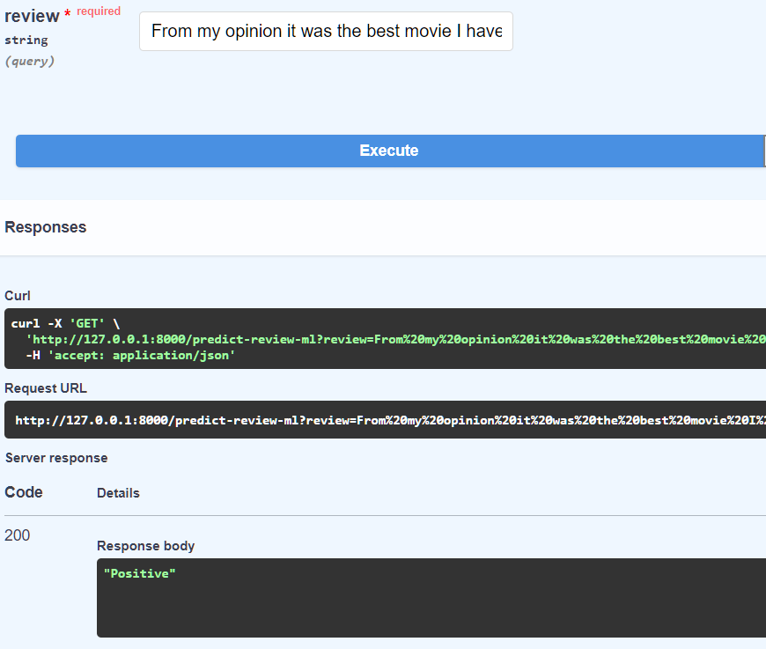
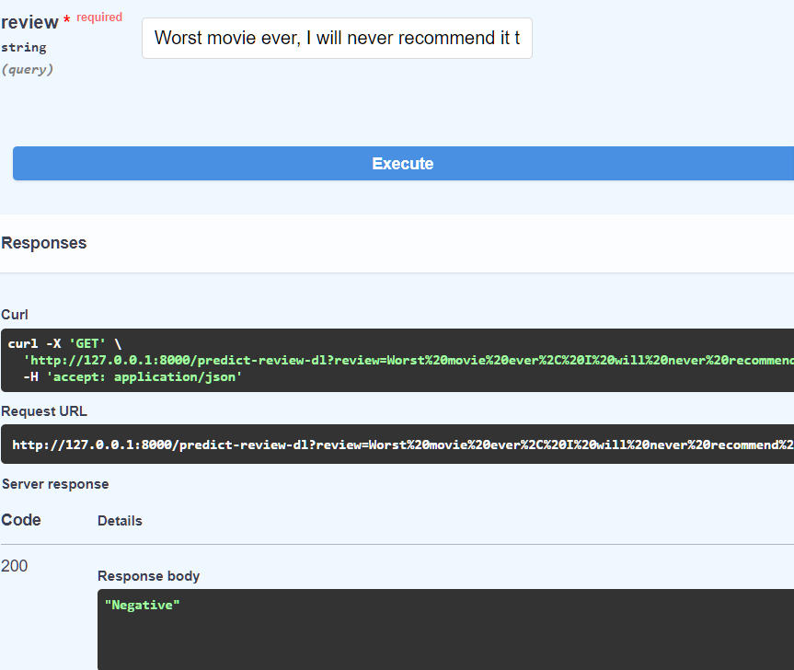
ML Prediction Result
DL Prediction Result

Slide 15
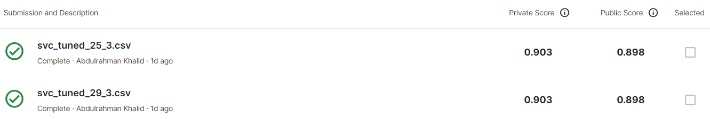
Kaggle Score
Public Score
Private Final Score
Submissions Score

Slide 16
Questions…

